Slide 1
Visionary Leadership in Healthcare Excellence in Practice, Policy, and Ethics
Holly Wei, PhD, RN, NEA-BC, FAAN
Sara Horton-Deutsch, PhD, RN, PMHCNS, FAAN, ANEF

Slide 2
Chapter 21. Creating a Connected World: A Call to Ethics of Face and Belonging
Con
Contributors Mark D.Beck, DNP, MSN, BS, RN
Stephanie Wilkie Ahmed, DNP, NP-BC
Sara Horton-Deutsch, PhD, RN, PMHCNS, FAAN, ANEF

Slide 3
Learning Objectives
Manifest a shared vision for nursing leadership as a foundation for all endeavors (service and academic partnerships)
Remain open to solutions that honor multiple sides and perspectives
Explain the Ethics of Face and Belonging for creating an environment where everyone wants to belong
Use silence, listening, reflection, seeing and accepting each person as a whole, and other principles and practices of emergent strategies to hold space for change

Slide 4
Three important aspects of Chaos Theory (Brafman & Pollack, 2013): 1. Appreciation of White Space 2. Invitation to ‘Unusual Suspects’ 3. Allowing for Serendipity

Slide 5
VUCA 2.O (Yoder-Wise, 2021)
Volatility to vision
Helps to clarify and refine what future is envisioned
Uncertainty to Understanding
Focuses on deep listening to understand the nuances of issues
Complexity to CLARITY
Focuses on the big picture: the goal to be achieved and the commitment required
Ambiguity to AGILITY
Reveals where the pivot points reside within the current system and where it may need resources and support

Slide 6
21st Century Conceptual Age
1. Design
2. Story
3. Symphony
4. Empathy
5. Play
6. Meaning
6 Human Attributes Required in the Conceptual Age
(Pink, 2005)

Slide 7
Paradoxes and Polarities (Johnson, 2020; Wesorick, 2016)
The Key to relational capacity
Beyond Either/Or to Both/And

Slide 8
Social Determinants of Health (SDOH)
SDOH are the conditions in the environments where people are born, live, learn, work, play, worship, and age and which affect a wide range of health, functioning, and quality-of-life outcomes and risks.
Those who live in the margins of society are often at higher risk for health-related impacts from SDOH. Some examples include:
Food insecurity
Housing
Transportation
Low literacy
Underemployment
Social Determinants of Health - Healthy People 2030 | health.gov

Slide 9
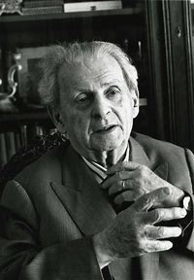
In Levinasian Ethics, the ethic of belonging is the antecedent to being. In recognizing the face of another, there is an inherent responsibility to the person. Totality & Infinity
Emmanuel Levinas

Slide 10
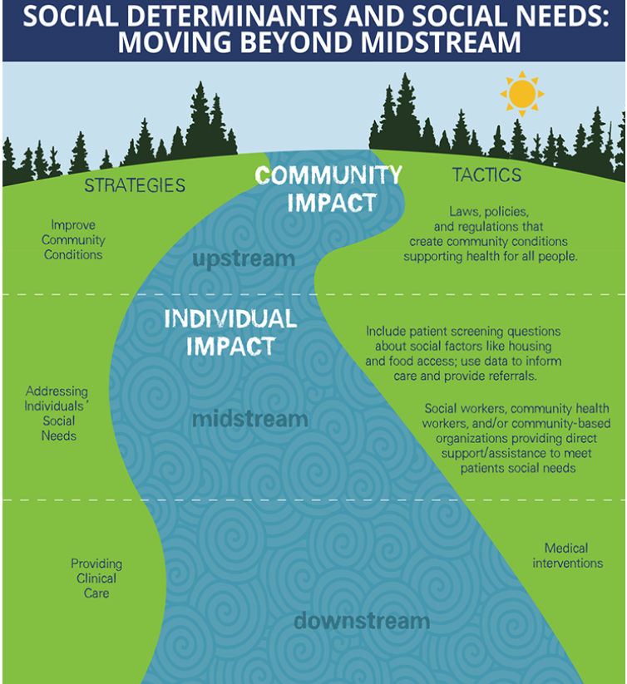
Castrucci & Auerbach
How can health be reframed upstream?
What tactics can be used to promote a culture of community health?
Beyond the “usual suspects,” how could unique cross-sector relationships be used to solve for problems such as food or housing insecurity, or food desserts?
How might nursing reconceptualize our traditional roles to promote community well-being?
Source:
Meeting Individual Social Needs Falls Short Of Addressing Social Determinants Of Health | Health Affairs

Slide 11
Emerging Strategies (Brown, 2017)
Small is good.
Change is constant.
There is always enough time for the right work.
There is a conversation in the room only these people can have. Find it.
Never failure, always lessons.
Trust the people.
Core Principles

Slide 12
Holding Space~Holding Change
“To ‘hold change’ or ‘hold space’ is to hold both the people in, and the dynamic energy of, a room, a space, a meeting, an organization. To hold change is to make it easy for people with shared intentions to be around each other and move towards their vision and values and to navigate conflict in a way that is generative and accountable.”
Adrienne Brown, 2021

