Slide 1
Visionary Leadership in Healthcare Excellence in Practice, Policy, and Ethics
Holly Wei, PhD, RN, NEA-BC, FAAN
Sara Horton-Deutsch, PhD, RN, PMHCNS, FAAN, ANEF

Slide 2
Chapter 16. Leadership in Promoting the Use of Evidence
Contributors Lynn Gallagher-Ford, PhD, RN, EBP-C, NE-BC, DPFNAP, FAAN
Laura Caramanica, PhD, RN, CNE, CNEP, FACHE, FAAN

Slide 3
Learning Objectives
Describe the differences between the four domains of evidence
Explain the critical role the nurse leader assumes in the application of evidence in the clinical setting
Apply leadership competencies for evidence-based practice
Justify why evidence is needed to support decision-making and clinical practice in the healthcare setting

Slide 4
Healthcare organizations in the 21st century need to be capable of bringing the best and most current knowledge to the bedside, chairside, or tableside—wherever care is delivered.
To achieve this, organizations must incorporate science/evidence as the underpinning for solving clinical problems.
Doing so requires a thorough understanding of four domains that support best practice/care/outcomes.
Each of the domains represents the use of evidence in one way or another. The domains include:
Research (the generation of new evidence)
Evidence-based practice (determination of the current, best evidence to support care)
Innovation (the ability to imagine new approaches to care based on the platform of evidence)
Process improvement (determination of the best processes to deliver the best evidence-based care)
Figure 1 depicts the four domains of the use of evidence.
Research generates Evidence
Evidence generates best practice.
Evidence is the foundation of Innovation
Innovation enhances Evidence-based, best Practice
Evidence-based, best practice is delivered via Process Improvement
Best care delivered ...
every time.

Slide 5
Leaders must understand the differences between the 4 domains and leverage their synergies
Research is “a systematic process used to generate new knowledge or evidence” (Melnyk & Morrison-Beedy, 2018, p. 4).
Process improvement (PI) is a rigorous approach that may be used for a variety of aims, including streamlining operations and production activities, reducing costs and billing cycles, or improving the quality of processes.
Evidence-based practice is a problem-solving approach that integrates the best evidence from research with a clinician’s expertise and a patient’s personal preferences and values (Melnyk & Fineout-Overholt, 2019, p. 8) to make clinical decisions.
Innovation is a “rigorous and generative process that leads to something new” (Porter- O‘Grady & Malloch, 2017, p. 4; Morrar, 2014).

Slide 6
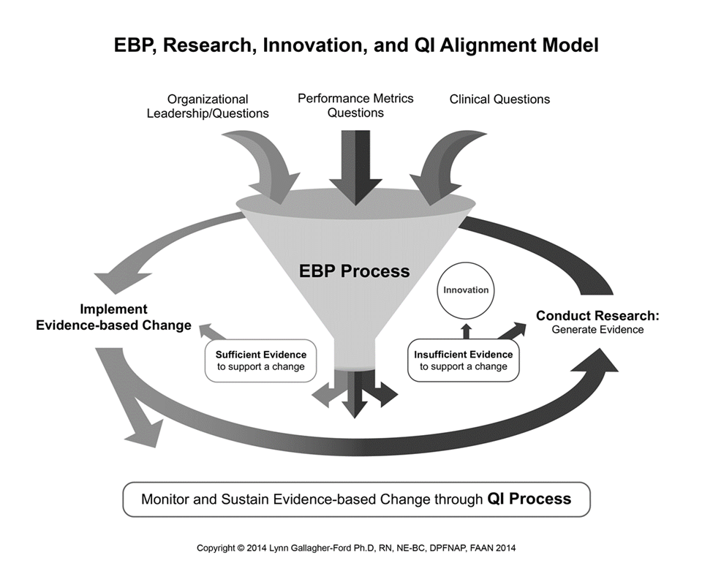
Each of these domains is discrete from the others, and each has unique methodological rigor, yet they coexist; they are codependent and synergistic (Porter-O’Grady & Malloch, 2017), and together they are the elements required to be able to reap the benefits of the comprehensive “use of evidence.”
The EBP, Research, Innovation, and
QI Alignment Model
depicts the four discrete domains of use of evidence aligning.

Slide 7
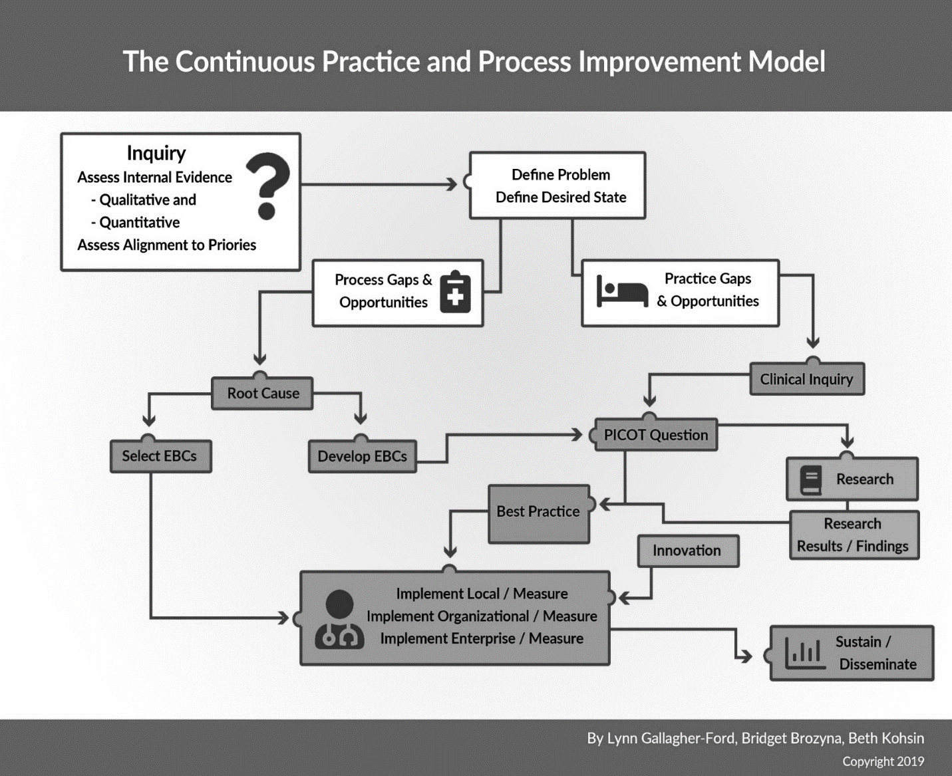
The Continuous Practice and Process Improvement Model depicts the four domains of use of evidence (research, EBP, innovation, and process improvement) conceptualized individually and synergistically.

Slide 8
Leaders must value and support this continuum by creating appropriate organizational room and support for best, evidence-based care and true innovation to exist and thrive together to deliver best care for patients, families, and clinicians.
This cannot be achieved by creating or maintaining siloes for each of these domains in an organization.
Instead, leaders will need to deconstruct and reconfigure traditional, siloed departments and pull together experts from each of the four domains into the same “new department.”
For this to be fiscally possible and sustainable, those who are experts in each of these fields will need to gain new expertise across the continuum. PI experts will need to learn EBP, EBP mentors will need to learn PI and innovation, and researchers will need to learn EBP and innovation, and on and on.
Gaining further competence in each of these domains is possible through participation in formal and informal education and skill-building programs that are readily available.

Slide 9
Evidence-based practice (EBP) was named as a required core competency for healthcare professionals by the Institute of Medicine (IOM) almost two decades ago, yet not actualized in most healthcare organizations.
Top barriers to EBP included lack of time, unsupported organizational culture hampered by politics, lack of EBP knowledge and education, lack of access to needed data, and leader or manager resistance!
Nurse leaders report their top priorities are healthcare quality and safety, and EBP is a low priority.
Many CNEs do not understand that EBP is the methodological approach required to improve practice and the direct pathway to quality and safety.
Resistance to EBP has endured for decades, and outcomes remain less than adequate even though creating and sustaining an evidence-based enterprise is completely achievable if leaders decide it is a strategic priority.

Slide 10
Leaders are critical to the integration and sustainability of EBP, and therefore for the use of evidence.
Required:
Engaged leaders who have the attributes of competence, commitment, courage, and persistence to build a culture of inquiry throughout the organization and cultivate an environment where the use of evidence is an expectation (i.e., the standard of care), not the exception.
Available:
Frameworks, models, assessment tools, templates, and systematic road maps
EBP competencies for frontline clinicians
EBP competencies for managers and leaders
Without leaders doing their part, nothing happens.
In this case, the nothing we are talking about is quality care and desired outcomes for patients, their families, and clinicians.

Slide 11
Organizational Culture and Readiness for the Use of Evidence
Organizational culture and readiness need to be assessed and addressed on an ongoing basis.
Several tools are available that can be used to conduct an organizational assessment.
Culture and readiness are not the same thing, and it is critical for leaders to understand both.
Organizational culture sets the context for everything an enterprise does.
Readiness is....prepared mentally and/or physically for some experience or action.
Leaders must be prepared to not only build the use of evidence house; they must also be prepared to maintain or repair it when needed!

Slide 12
Models and Frameworks for EBP that Support the Use of Evidence
It is not easy to build an organization that supports the use of the evidence continuum.
It is probably even more difficult to convert an existing, tradition-based organization.
GOOD NEWS!
Tools and resources are available to help leaders build a use of evidence house.
Organizational models: Systemwide models for implementation of EBP (ARCC and PARIHS)
Practice change models: Guide clinicians through the specific steps of a practice change initiative (ARCC, Seven Steps, Iowa, Hopkins)

Slide 13
Language and Nomenclature
The utilization of common, shared, appropriate language/nomenclature related to the use of evidence domains is critical
The language/nomenclature of each evidence domain are specific, unique, and not interchangeable
Leaders are responsible for being well-versed in the language/nomenclature of each of the evidence domains
Leaders must model the correct use of the unique language/nomenclature of each domain
Leaders must coach and mentor others in the proper use of domain-specific language/nomenclature.

Slide 14
Implementation Science
The field of implementation science (IS) has made significant contributions in generating evidence on effective approaches for EBP implementation in practice settings to address facilitators and barriers
Numerous trials have been conducted to examine the effectiveness of specific implementation strategies that promote the adoption of evidence
A great deal has been well-disseminated for organizations to use to promote the implementation of evidence
Application of this knowledge is not routine in healthcare
Employing common language related to use of evidence would:
Promote accurate dissemination of evidence-based work
Enhance capacity to assess the effectiveness of evidence-related strategies
Build the body of knowledge related to evidence-based practice
Improve outcomes on a large, global scale

Slide 15
Leadership Competencies for Evidence-Based Practice
Nurse leaders, equipped with advanced education and expertise on how to impart evidence into practice can remove barriers to use of evidence.
Minimizing or removing the barriers of time, resources, and inadequate knowledge is critical for evidence-based practice, innovation, and performance improvement to synergistically inform healthcare operations and clinical decisions.
Many strategies are available for leaders to utilize to promote the use of evidence, and an important one is the use of competencies to guide performance expectations related to EBP.

Slide 16
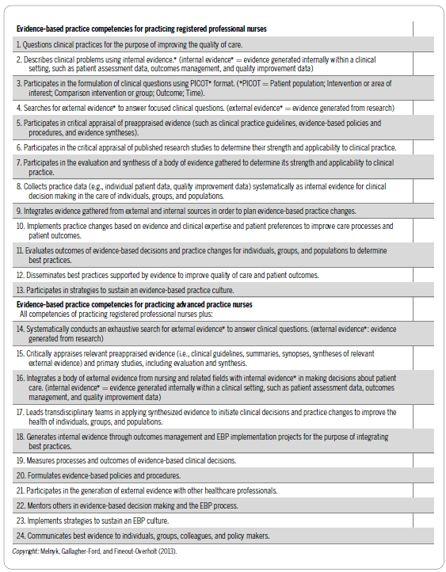
EBP Competencies for Practicing Registered Nurses and Advanced Practice Nurses
Delphi study in 2014; Melnyk et. al.
24 EBP competencies:
13 for practicing nurses and
11 additional competencies for advanced practice nurses

Slide 17
Nurse Manager Competencies to Support Evidence-Based Practice
Caramanica et al. (2021)
22 leadership competencies to enable frontline leaders to successfully support clinicians in the use of evidence-base practice in the clinical setting
 | Leading Evidence-Based Practice
1. | Identifies own vital role in enabling evidence-based practice.
2. | Serves as a champion for evidence-based practice projects by readily checking on progress, providing feedback, removing barriers, and offering encouragement.
3. | Develops strong relationships with staff and leaders for the advancement of evidence-based practice.
4. | Prioritizes evidence-based practice projects to align with organization’s goals.
5. | Influences formal organizational policies to enable evidence-based practice.
6. | Facilitates the conduction and implementation of evidence-based practice.
7. | Applies best evidence to make leadership decisions.
8. | Evaluates the adoption of an evidence-based culture.
 | Building Infrastructure for Evidence-based Practice
9. | Assesses readiness for evidence-based practice in the clinical practice environment.
10. | Assesses staff commitment to engaging in evidence-based practice.
11. | Justifies financial resources in support of evidence-based practice.
12. | Appraises policies, procedures, and standards of practice to ensure these are evidence-based.
13. | Facilitates allocation of multiple resources required to expand evidence-based practice.
 | Promoting Evidence-based Practice
14. | Demonstrates competency in evidence-based practice (knowledge, skill, and attitude).
15. | Promotes the value of evidence-based practice by connecting it to quality, safety, and patient care outcomes.
16. | Provides staff access to education on evidence-based practice.
17. | Provides staff access to evidence-based practice experts and mentors.
18. | Facilitates staff access to relevant data needed for evidence-based practice.
19. | Ensures staff are provided time needed to participate in evidence-based practice.
20. | Holds staff accountable for the integration of evidence-based practice into practice commensurate with their level of clinical expertise/role.
21. | Provides meaningful recognition of staff and mentors who engage in evidence-based practice.
22. | Promotes the expectation that organizational decisions are made using evidence.

Slide 18
Nurse Manager Competencies to Support Evidence-Based Practice
Leading Evidence-based Practice
Identify their vital part in building the EBP culture
Demonstrate their role as a key standard-bearer for the use of evidence
Use their influencing leadership skills to set the expectation for the incorporation of evidence-based care
Align EBP with organizational priorities
Build the organizational capacity to fully utilize the best evidence to achieve the best outcomes

Slide 19
Nurse Manager Competencies to Support Evidence-Based Practice
Building Infrastructure for Evidence-Based Practice
Formation of strong partnerships
Empower clinicians with the authority and autonomy to change practice
Allot adequate time away from their other work to conduct use of evidence activities
Adequately resource clinicians to conduct use of evidence work (computers, access to databases, librarian support)
Implementation infrastructures must be in place, hardwired, and fully supported
Public and timely removal of barriers and resistance so that best, evidence-based practice can be achieved

Slide 20
Nurse Manager Competencies to Support Evidence-Based Practice
Promoting Evidence-Based Practice
Model the use of evidence by integrating evidence into leadership practice decisions
Enable clinicians to attend workshops to learn the skills necessary for the use and application of evidence
Ensure the availability of an adequate number of evidence experts to mentor clinicians
Cultivate a shared value for the use of evidence by clinicians and other key stakeholders
Hold all clinicians accountable to engage in EBP commensurate with their knowledge, skills, and role responsibilities
Provide meaningful and continuous rewards and recognition

Slide 21
Implications for Nursing Practice
Nursing leadership, at all levels, is an essential factor in the establishment and sustainability of healthcare enterprises where clinicians use evidence in 90% of their decisions and ensure the delivery of safe, quality care and services.
Nurse leaders who achieve competence in the use of evidence will make effective decisions, and their actions will result in the attainment of targeted outcomes.
By setting the example as evidence-based leaders, they will model the way,
thus creating future leaders who will ensure the sustainability of evidence-based care.
This, in turn, will provide the necessary platform upon which
global health is possible.

