Slide 1
Visionary Leadership in Healthcare Excellence in Practice, Policy, and Ethics Holly Wei, PhD, RN, NEA-BC, FAAN Sara Horton-Deutsch, PhD, RN, PMHCNS, FAAN, ANEF

Slide 2
Chapter 11. Promoting Exceptional Patient Experience Through Compassionate Connected Care Contributors Mary Jo Assi, DNP, RN, NEA- BC, FAAN Senem Guney, PhD

Slide 3
Learning Objectives
After completing this chapter, the learner will be able to:
Understand a data-driven model of human caring: the Compassionate Connected Care model
Comprehend AI-enabled insights into human caring from patients’ perspectives
Explain leadership’s roles in maximizing patients’ voice through patients’ experience

Slide 4
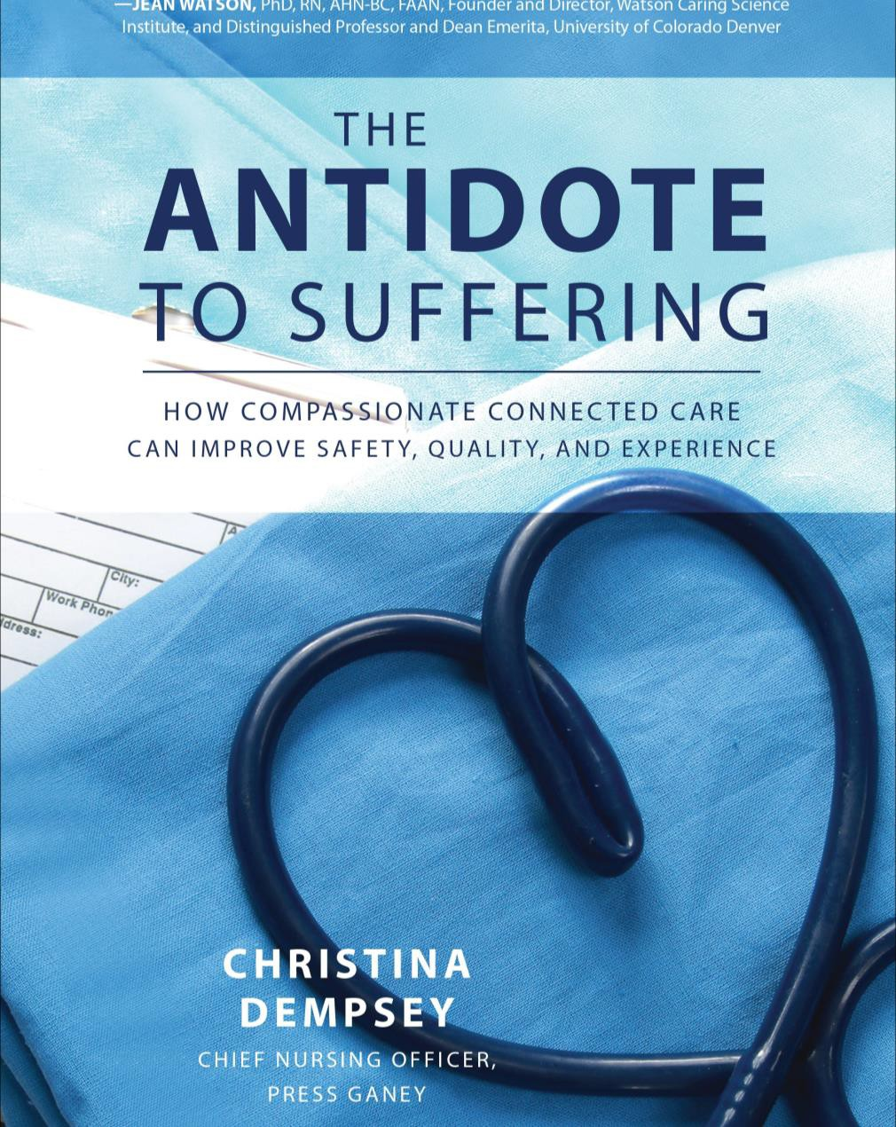
Compassionate Connected Care®
Model developed in 2013-2014
Research methodology included Affinity Diagrams
Connects the patient and caregiver voice to action to reduce suffering
4

Slide 5
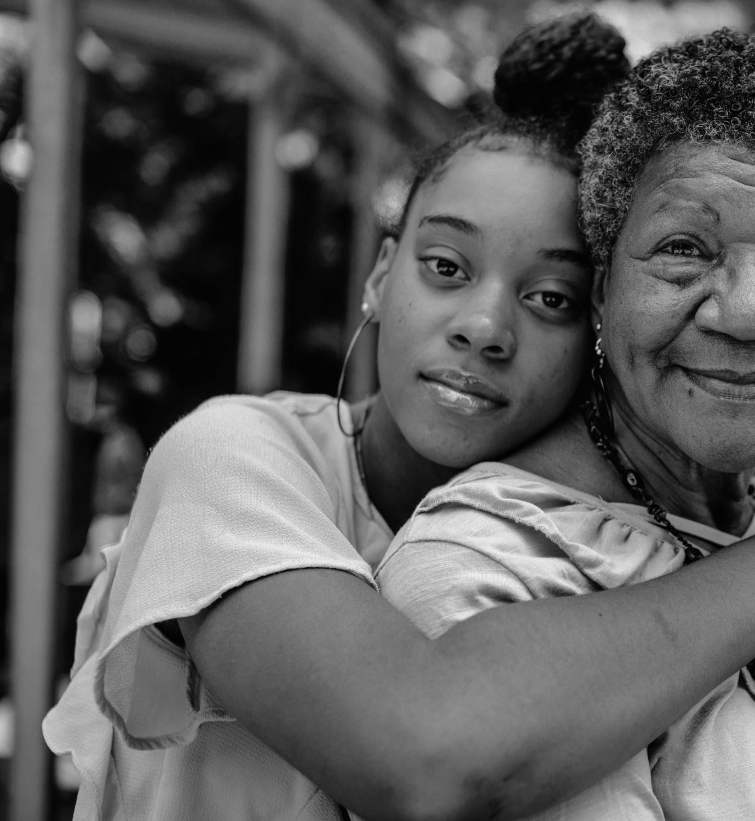
Compassionate Connected Care® For the PATIENT
ACKNOWLEDGE SUFFERING
CLINICAL EXCELLENCE
Discharge Prep, Clinical Skill, Pain Control
CONNECTED CARING BEHAVIORS
Empathy, Courtesy, Inform, Personalize, Privacy, Choice,
Service Recovery
BODY LANGUAGE MATTERS
ANXIETY IS SUFFERING
COORDINATE CARE
AUTONOMY REDUCES SUFFERING
CARE TRANSENDS DIAGNOSIS
CULTURAL
OPERATIONAL EFFICIENCY
Mission/Values Teamwork
Patient-Centeredness Improvement Focus Safety as Priority
Environment, Wait,
Amenities
QUALITATIVE COMPONENTS
QUANTITATIVE COMPONENTS
PATIENT EXPERIENCE
5

Slide 6
It Takes Less Than a Minute to Establish a Human Connection
56 Second Connection

Slide 7
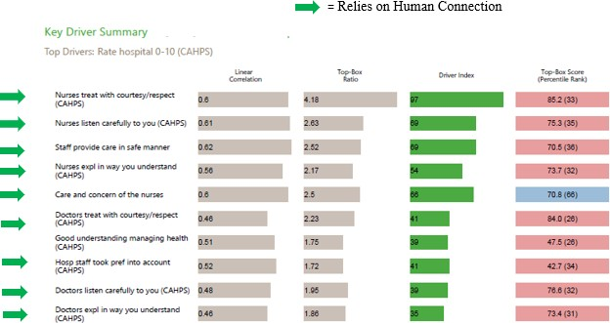
Example: Key Driver Report (Inpatient)
5

Slide 8
Application to Practice
The Quality of Every Encounter
What: Best Practices
Rounding
Bedside Shift Report
Huddles
When: Consistently
100% of the practices
100% of the time
How: Compassionate Connected Care®
Move away from task orientation only
Prioritize human connection

Slide 9
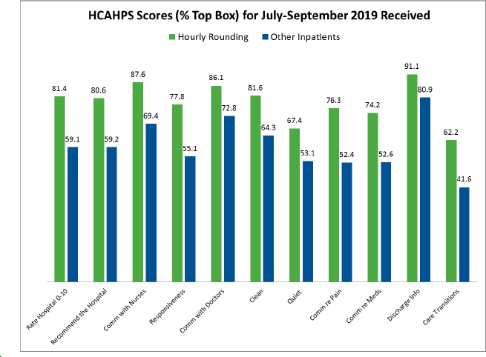
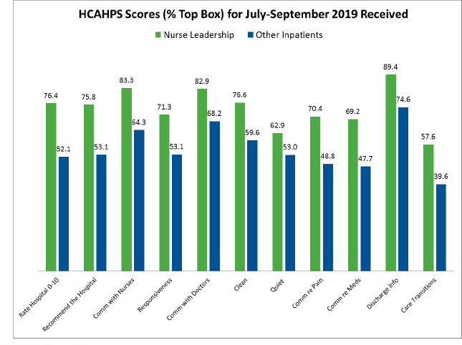
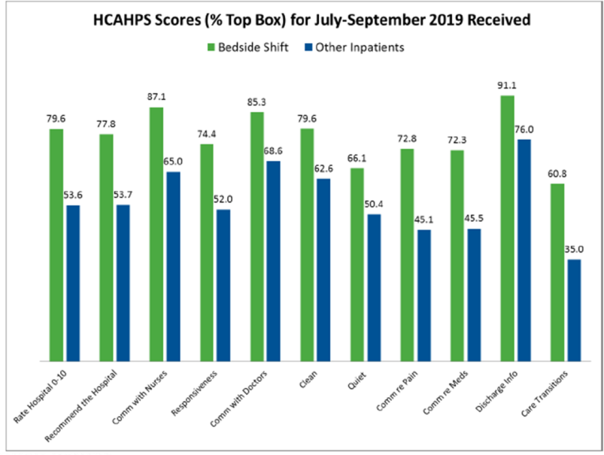
National Data

Slide 10
Compassionate Connected Care® Defining Caring Behaviors
Behaviors
56s Connection
Active Listening Empathy
Sit Down: Eye to Eye & Heart to Heart
Provide an opportunity for questions
Seek Clarification
Shared decision making – Ask the patient’s goals
Be clear and avoid jargon
Be Aware of Body Language
3 As of Recovery
8
Make a Compassionate Connection
Anxiety is Suffering
Acknowledge Suffering
Universal Relationship Skills
Invite
Participation
Autonomy Reduces Suffering
Compassionate
Connected Care®
Communicate with Intentional Language
Body Language Matters
Follow-Up and Follow-Through
Caring Transends Diagnosis
Ensure effective Handoffs/ Teamwork Transitions
Coordinate Care

Slide 11
Strong Employee Engagement
Results in Improved Patient Experience
National Percentile Rank Based on Employee Engagement Scores ⁽¹⁾
100
80
73
Median National Percentile Rank
70
63
66
62
59
60
47
47
40
36
32
30
28
26
28
20
0
Nurse
Responsiveness Physician
Top Quartile of Employee Engagement
Pain
Medication Discharge
Bottom Quartile of Employee Engagement
Rating
1. Based on Engagement data from year 2016. HCAHPS data from Hospital Compare, 2016 discharges. Created by Data ScienceTeam.

Slide 12
Compassionate Connected Care® For the Caregiver
COMPLEXITY AND GRAVITY OF THE WORK
CLINICAL EXCELLENCE
Providing Quality Care Providing Safe Care
CONNECTED CARING BEHAVIORS
Cared About, Belong, Enjoy Work, Recognition, Respect,
Trust, Job Security
MANAGEMENT SUPPORT
TEAMWORK
EMPATHY AND TRUST
WORK/LIFE BALANCE COMMUNICATION
CULTURAL
OPERATIONAL EFFICIENCY
Mission/Values Teamwork
Patient-Centeredness Improvement Focus Safety as Priority
Job Fit, Clarity, Pay/Benefits Work Training, Development, Physical/Staff Resources Management, Leadership Input,
Feedback, Autonomy Communication
QUALITATIVE COMPONENTS
QUANTITATIVE COMPONENTS
CAREGIVER EXPERIENCE
7/12/2021

Slide 13
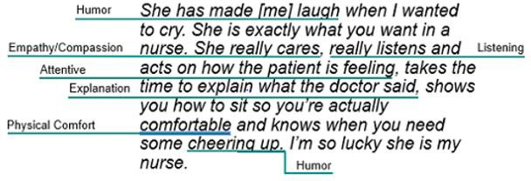
Patient’s Perspective of Human Caring
Narrative comments reveal the rich context of human caring from the patient’s perspective
AI analysis provides insights from
thousands of narrative comments
AI shows aggregate trends from patients’ words and creates a narrative evidence basis to understand patients’ needs and expectations
7/12/2021

Slide 14
Hearing What Patients Say
Patients often describe more than one aspect of human caring in their comments
“My nurses were so understanding with me, but the doctor always seemed
rushed.”
Expert AI should analyze narrative comments phrase- by-phrase
7/12/2021

Slide 15
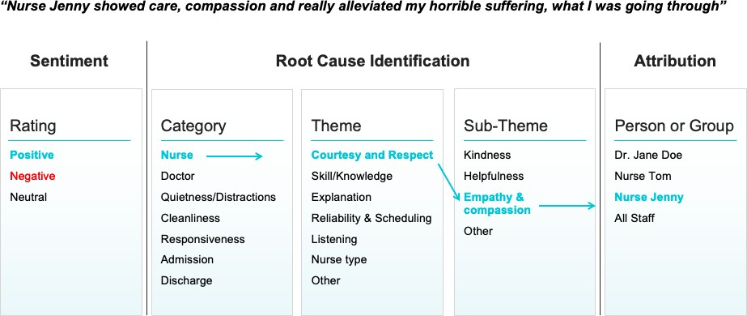
AI Analysis of Narrative Data
7/12/2021

Slide 16
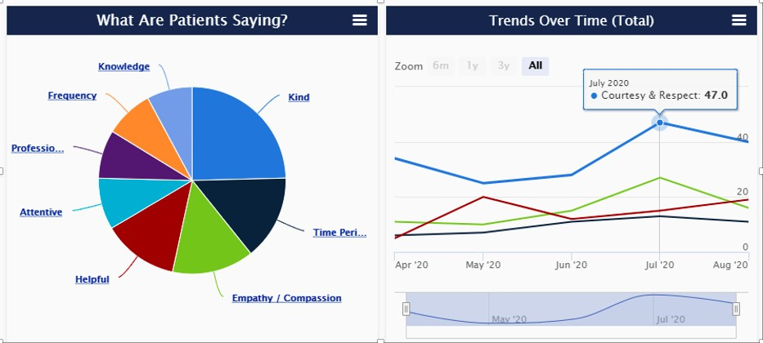
Aggregate Trends From Narratives
What matters the most
Based on patients’ words
Patients value the caring aspect of nursing significantly more than the knowledge aspect.
7/12/2021

Slide 17
Building a Narrative Evidence Basis for Compassionate Connected Care
7/12/2021

