Slide 1
Visionary Leadership in Healthcare Excellence in Practice, Policy, and Ethics
Holly Wei, PhD, RN, NEA-BC, FAAN
Sara Horton-Deutsch, PhD, RN, PMHCNS, FAAN, ANEF

Slide 2
Chapter 9. Quantum Caring Leadership: A New Ontology Into Practice
Contributors Jean Watson, PhD, RN, AHN-BC, HSGAHN, FAAN, LL (AAN)
Tim Porter-O’Grady, DM, EdD, ScD, APRN, FAAN, FACCWS Sara Horton-Deutsch, PhD, RN, FAAN, ANEF
Kathy Malloch, PhD, MBA, RN, FAAN
Jim D’Alfonso, DNP, RN, PhD(h), NEA-BC, FNAP, FAAN

Slide 3
Learning Objectives
After the completion of this chapter, you will be able to:
Distinguish the unitary principles of wholeness in nursing from the separatist principles of healthcare leadership
Define the intersecting principles of Caring Science and Quantum Leadership
Describe Quantum Caring Healthcare Leadership and its principles
Critique the theory for leading in a quantum unitary reality to sustain humanity

Slide 4
Unitary vs Separatist Thinking in Nursing
Unitary Worldview
Current theories and scholarship make the case for unitary thinking as the highest level of consciousness, congruent with the nursing phenomena
Definitions reflect the disciplinary focus on wholeness, along with nursing’s ethical-moral covenant to sustain human caring-healing and health, requiring an evolved consciousness of oneness and connection.
This awareness transcends differences through a human-to-human authentic connection; unitary consciousness seeks to avoid dualism of “either/or” thinking, embracing “both/and” reality
Separatist Worldview
Particulate-Deterministic and Interactive-Integrative nursing paradigms are examples of parts-focused worldview
A parts-focused worldview or ontology; parts versus wholeness— meaning the human is separate from the environment and wider universe; mind is separate from body, and so on
Relations and processes in the human environment field, are separate entities we seek to control or at least interact with to manage our body, our physical field, and environmental reality

Slide 5
Newtonian Leadership Characteristics
Principles of healthcare leadership are still largely embedded in first revolution Newtonian physics of separatist, outdated principles, versus the unitary principles of our human-environment-universe.
Examples include:
Hierarchical structures
Focus on control
Vertical orientation
Reductionist scientific processes
Top-down decision-making
Mechanistic models of design
Process-driven action

Slide 6
Quantum Thinking in Healthcare Leadership
A second revolution in quantum thinking is uncovering that at the micro-macro (universe) level of the physical world, everything is connected
Quantum leadership principles emphasize:
Integration
Synthesis
Relatedness and
Recognize that change is not a thing or an event, but rather a dynamic, that is constitutive of the universe
Quantum worldview parallels the growing commitment of nursing scholars to unitary thinking for nursing phenomena

Slide 7
Quantum Leadership Science
Scholarship in quantum leadership offers a new level of unitary consciousness in nursing and healthcare leadership education and practices (Porter O’Grady and Malloch, 2010, 2015, 2017)
Unitary, quantum converging themes, can be found in quantum leadership science and are congruent with the unitary field of thinking and the “second quantum revolution”
Quantum leadership characteristics are in direct contrast to conventional parts-focused (Newtonian) healthcare leadership principles
Newtonian approaches reflect the particulate-deterministic paradigm; their work then evolved from the transactional parts-model (Interactive paradigm) to the quantum level, consistent with a Unitary Caring Science worldview.

Slide 8
Caring Science
Caring Science is an extant, evolved model of science, grounded in a moral-ethical ontological framework of relations and unity, that promotes and sustains human dignity, caring-healing, and health for all (Watson, 1999, 2005, 2008, 2017)
Caring Science scholarship and the theory of transpersonal caring have sought to transform nursing from the inside out, by an expanded discipline specific unitary worldview, acknowledging nursing’s covenantal relation with global humanity, and transpersonal caring moments
Caring Science Theory seeks to sustain human caring-healing and love through knowledgeable, compassionate service to humankind

Slide 9
The 10 Caritas Processes®: The Universals of Human Caring and Love
Caritas Processes help guide the caring-healing practitioner-leadership principles for patients, nurses, and healthcare systems around the world (Watson, 2008)
Sustaining Humanistic-Altruistic values—Practice of loving kindness-compassion and equanimity for self/other.
Being Authentically Present—Enabling Faith-Hope; Honoring subjective, inner, lifeworld of self/other.
Being Sensitive to self/others, by cultivating own spiritual practices, beyond ego-self to transpersonal presence.
Developing and sustaining loving, trusting caring relationships.
Allowing for expression of positive and negative feelings—Authentically listening to another person’s story.
Creatively problem-solving to ‘solution-seeking’ through caring process; full use of self—Artistry of caring-healing practices.
Engaging in Transpersonal teaching-learning caring relationship; Staying within other’s frame of reference—Shift toward coaching model for health-wellness.
Creating a Healing environment at all levels —Subtle energetic authentic presence.
Reverentially assisting with basic needs as sacred acts; Touching the spirit of others; Sustaining human dignity.
Opening to existential-spiritual, mystery, unknowns—Allowing for miracles.

Slide 10
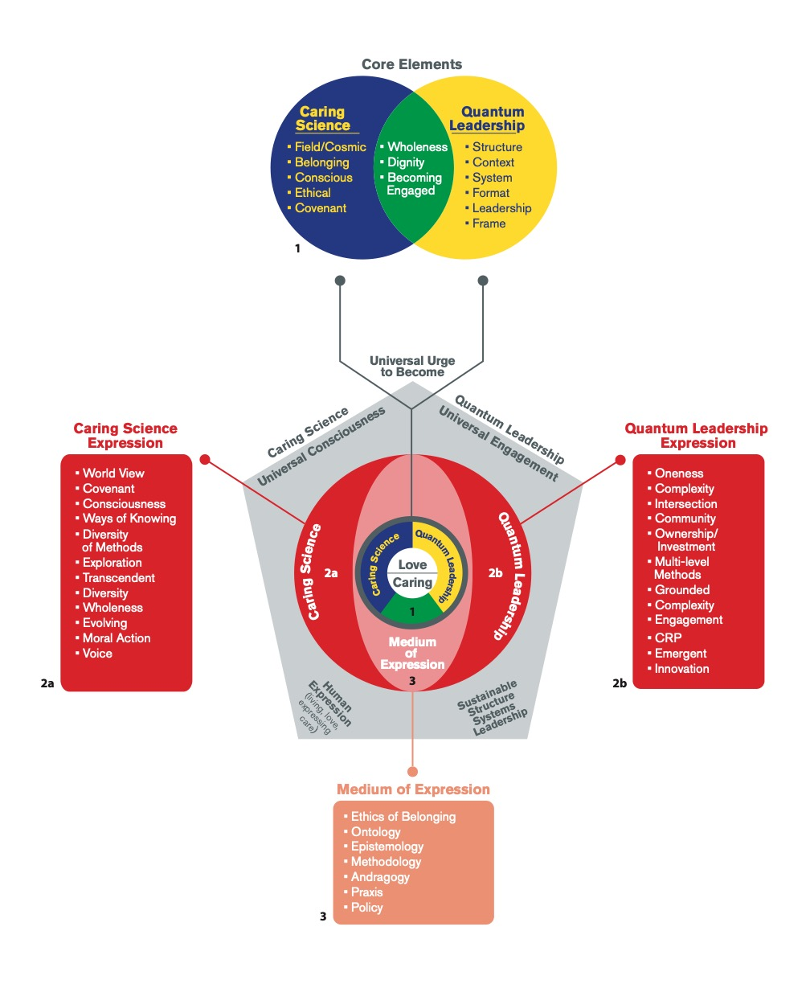
Unitary Convergence: QL Science and Transpersonal CS
By transposing Caring Science (CS) and Quantum Leadership (QL) into a disciplinary matrix context, we find congruence.
This congruence is at the philosophical-ethical, ontological, theoretical level.
The new integration unites quantum and caring leadership toward a distinct disciplinary foundation for new leadership practices and principles.
Unitary Disciplinary-Specific Commonalities comprise shared, nursing ethic, ontological, philosophical, epistemology, and praxis convergence for Quantum Caring HealthCare Leadership

Slide 11
Quantum Caring Healthcare Leadership Principles
Involve universality of human caring community as a quantum unitary phenomenon
Build upon the 10 Caritas Processes® of Caring Science, and Transpersonal Caring as theoretical guide for expanding nursing disciplinary foundation for new models of universal, caring healing healthcare
Builds upon Quantum Leadership principles of non-linear structures; relational-ethical accountability and complexity—quantum based models of design—allowing for ontological-infinite emergence of caring-healing health communities
The universals of Quantum Caring HealthCare Leadership integrate with Caritas Processes® of Transpersonal Caring Science theory, creating a language and structure for substantive human leadership models as quantum acts of love and caring
QCL principles build upon Unitary Caring Science ‘Ethic of Belonging and Love’ as nursing, discipline-specific, unitary ethical view of science—allowing for concepts such as non-local consciousness, non-physical phenomena, human caring transpersonal field, and human health (healing) experiences mystery, infinite unknowns
The discipline of Nursing and QCL principles are grounded in a unitary view of science and nursing phenomena distinctly evolved beyond the conventional Western, separate-parts paradigm, and Newtonian worldview of science
The Unifying framework of QCL grounds the discipline within an expanding view of science, adhering to nursing’s moral-ethical imperative as the starting point to sustain humanity itself and specifically, human caring-healing and health practices for our world
New patterns of quantum caring leadership principles offer directions for whole person—whole system, caring-healing, global healthcare organizations

Slide 12
Implications for Nursing Practice
Two divergent areas: Caring Science and Quantum Leadership scholarship have evolved separately.
Using a disciplinary ontological-ethical matrix analysis, convergence and synergy were uncovered between quantum knowledge, unitary thinking, caring science, and quantum leadership: Quantum Caring HealthCare Leadership Model.
An evolved Quantum Caring HealthCare Leadership Model invites new provocative thinking and critique, both for the discipline, as well as an informed new unitary, quantum caring consciousness for all healthcare leadership.

Slide 13
Summary
Nursing leadership continues to evolve from transformative, transactional leadership principles to a unitary quantum caring worldview
Caring Science has evolved more explicitly, underpinned by “second quantum revolution” science, and quantum leadership principles
By integrating the ethics and unitary ontology of caring science with energetic quantum leadership principles, both Quantum Leadership and Caring Science are transformed and metamorphosed into a new discipline-specific entity: the Quantum Caring HealthCare Leadership Model

