Slide 1
Visionary Leadership in Healthcare
Excellence in Practice, Policy, and Ethics
Holly Wei, PhD, RN, NEA-BC, FAAN
Sara Horton-Deutsch, PhD, RN, PMHCNS, FAAN, ANEF

Slide 2
Chapter 3. Transcending Leadership and Redefining Success
Contributors Matthew S. Howard, DNP, RN, CEN, TCRN, CPEN, CPN
Christie Kerwan, MSN, RN
Elizabeth Madigan, PhD, RN, FAAN
Danielle EK Perkins, PhD, RN
Erica DeKruyter, MSN, RN
Sarah E. Gray, DNP, RN, CEN, FAEN

Slide 3
Learning Objectives
After completing this chapter, the learner will be able to:
Explain new models of leadership development based on complex adaptive systems and neuroscience
Describe Sigma’s experience with leadership development and lessons learned
Create the future of leadership development

Slide 4
New Models of Leadership Development
Incorporate knowledge from both the personal/anecdotal and the evidence-based
Recognize the impact of complex adaptive systems on the organization
Incorporate the neuroscience of interpersonal relationships among leaders and their followers

Slide 5
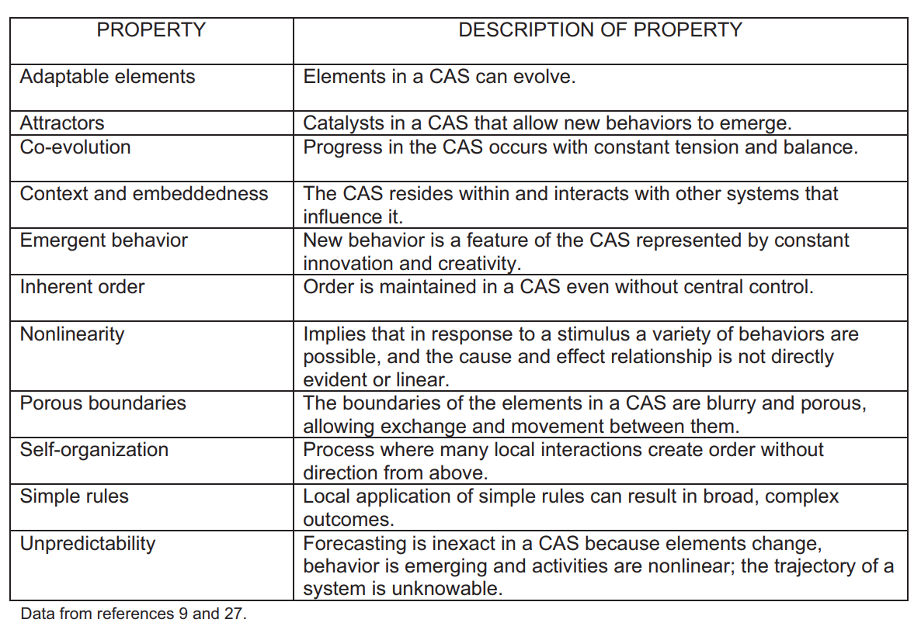
Principles Underlying Complex Adaptive Systems
(Chaffee & McNeill, 2007)

Slide 6
Implications for Leadership
Recognize the interpersonal nature of leadership versus the individual development approach.
Emphasize the importance of a learning environment where things are tried and some work and some do not; expecting and welcoming failure leads to a learning environment.
Create an environment that facilitates change and adaptability by promoting self-organization.
Recognize different perspectives as a good thing; a healthy level of conflict promotes progress.

Slide 7
Specific Neuroleadership Theory Development
Social qualities were found to determine the leader and the employee’s reactions. These reactions were identified as the SCARF model (Status, Certainty, Autonomy, Relatedness, and Fairness).
Using one’s ability to identify, understand, and react to these social qualities is paramount to successful leadership (Rock, 2008).
Social Quality | Biological impact | Response
Status | Increased/decreased cortisol release | Reward: longevity, health, calm
 |  | Threat: anxiety, stress
Certainty | Enhanced/inhibited neural connections between basal ganglia and motor cortex; adrenaline and dopamine release | Reward: confidence, innovative, productive
 |  | Threat: diminished memory, disengagement, overwhelmed
Autonomy | Increased/decreased adrenaline and dopamine release | Reward: calm; better decision-making
 |  | Threat: stress, disruptive, disengaged
Relatedness | Oxytocin release; increased endorphins (exact response as physical pain response) | Reward: friendly, collaborative, generous
 |  | Threat: lonely, isolated, rejected
Fairness | Increased/decreased endorphins | Reward: loyal, engaged, trust
 |  | Threat: untrusting, disruptive
SCARF Model: The reward and threat response to five social qualities

Slide 8
Brain Adaptive Leaders
“Embracing collaboration and cooperation, alongside the necessary competition and unavoidable conflicts, will advance them to true brain adaptive leaders” (Dimitriadis & Psychogios, 2020, p. 172).
    Cooperation, not competition, is how human brains evolved
    Basic constructs of leadership:
        Walk the talk
        Recognize the influence of mirror neurons
            There is evidence from psychology and organizational behavior that a leader’s mental and emotional state will be reflected by the followers

Slide 9
A Framework for Leadership Development
James Kouzes and Barry Z. Posner’s model, The Five Practices of Exemplary Leadership® is the culmination of having engaged with successful and diverse leaders about their behaviors and actions that they felt were enacted when they were at their “personal best”
  The five practices include:
    Model the Way
    Inspire a Shared Vision
    Challenge the Process
    Enable Others to Act
    Encourage the Heart
  CAS and neuroscience are reflected in the Kouzes and Posner five methods of leadership development.
  Served as the primary evidence-based framework for all of Sigma’s leadership development academies and programs.

Slide 10
Sigma Theta Tau International Honor Society of Nursing (Sigma)
An organization dedicated to advancing the status of nursing as a profession
Focuses on professional leadership and career development for all nurses
Was the first organization in the United States to fund nursing research in 1936
Recognized the need for nurses to obtain knowledge and skills in leadership, scholarship, and service

Slide 11
Sigma Programming
Established and utilizes leadership academies to provide formal leadership development to nurses within clinical and academic settings
    Current leadership academies:
      Experienced Academic Leadership Academy
      New Academic Leadership Academy
      Nurse Leadership Academy for Practice
Developed asynchronous educational programming to enhance the knowledge and skills of nurse leaders at various stages of their professional development
    Current online educational programs:
      The Nurse Manager Certificate Program
      Healthcare Leader Certificate Program

Slide 12
Sigma’s Leadership Experience
Past participants in Sigma’s leadership development programming have successfully gone on to accomplish various personal short- and long-term professional goals.
    Examples:
      Dr. Carolyn Hart was a former nurse leadership scholar and alumna of the Nurse Faculty Leadership Academy, Experienced Nurse Faculty Leadership Academy, and Emerging Educational Administrator Institute. As a result of supportive mentorship and expert guidance, she has assumed a Dean role and published her work based on her leadership development.

Slide 13
Sigma and Its Leadership Experience
    Examples continued:
      Dr. Michael Diño described the development and implementation of electronic web-based learning resources at Our Lady of Fatima University, Valenzuela City, Philippines; he led a team of stakeholders at his institution to bring about foundational technology enhancements to better support the future of nursing education and the inclusion of virtual and online learning across the university.
Nurse leaders and experts that support aspiring and novice leaders in nursing education and practice also benefit personally and professionally through their participation. The experience of mentoring and providing expert guidance to Sigma nurse scholars provides opportunities for publishing about Sigma programming, scholar outcomes, and individual personal growth.

Slide 14
The Future of Leadership Development
      Consists of personal/anecdotal and evidence-based approaches
      Grounded in the recognition of how change occurs within a complex adaptive system and in response to the neuroscience.
  As a result, leaders will need to be deeply authentic and exquisitely aware of their own state of being. Authentic leadership will require deep reflection, experiential learning and coaching to consider how one comes across.

Slide 15
Conclusion
  Nurse leaders must apply higher system thinking strategies.
  Nursing leaders should work to orchestrate CAS into clinical and academic environments.
  Nursing leadership training must evolve to include experiential opportunities.

