Slide 1
Welcome to your
Sigma Theta Tau International Chartering Ceremony and Induction

Slide 2
Welcome
Chapter Leaders and Guests
Optional list names
Optional list names
Optional list names
Optional list names
Optional list names
Optional list names
Optional list names
Optional list names

Slide 3
Welcome
Chartering Officer
Name and Title of Chartering Officer

Slide 4
Our Mission
Advancing world health and celebrating
nursing excellence in scholarship,
leadership, and service.
Our Vision
The global organization
of choice for nursing

Slide 5
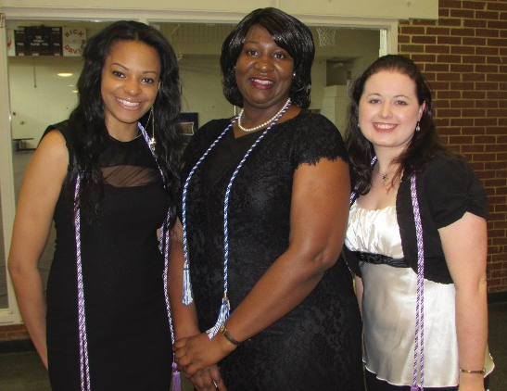
A Quick Look at Sigma today
Adams
Belford
Copeland
Lingeman
Miller
Wright

Slide 6

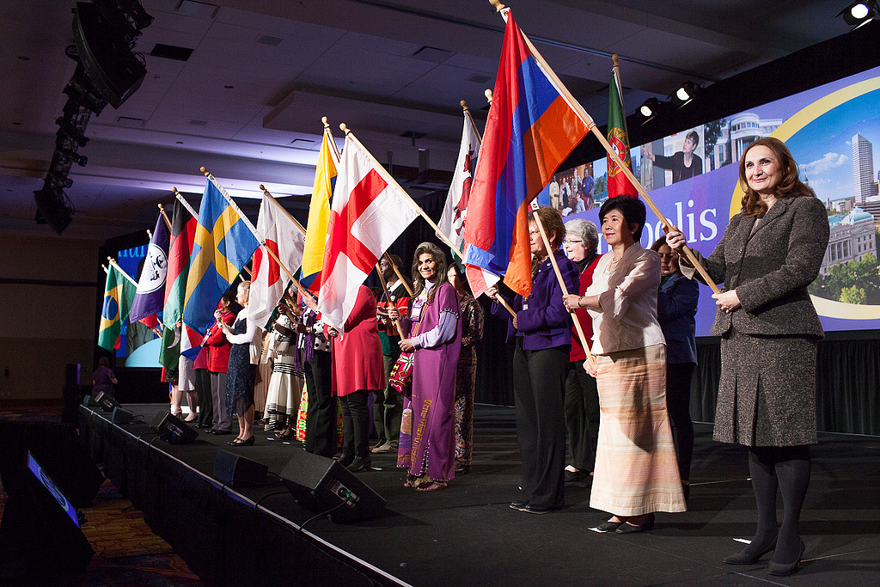
Distinguished Company
SIGMA MEMBERS BY THE NUMBERS:
35% HAVE ADVANCED DEGREES (MASTER’S OR DOCTORATE).
50% WORK IN A HOSPITAL OR MULTI-HOSPITAL SETTING
16% WORK IN SCHOOLS OF
NURSING

Slide 7


Slide 8



Name and Values
Love
Courage
Honor

Slide 9

The Crest
Wisdom and Discernment
Service, Professional Endeavor, and Strength of Leadership
Knowledge

Slide 10

The Key
Satisfaction of professional life
Six founders
Lamp of knowledge
Our charge

Slide 11


A Lifelong Resource
SIGMA MEMBERSHIP GAINS YOU YEARLY ACCESS TO:
Sign up with Sigma Marketplace to receive free specialty newsletters relevant to your career and purchase books and CNE courses at a discounted price.
Your membership gives you access to Sigma’s social networking site, The Circle. You will have access to various Communities of Interest, local and international volunteer opportunities, as well as the chance to network with your esteemed Sigma peers.

Slide 12
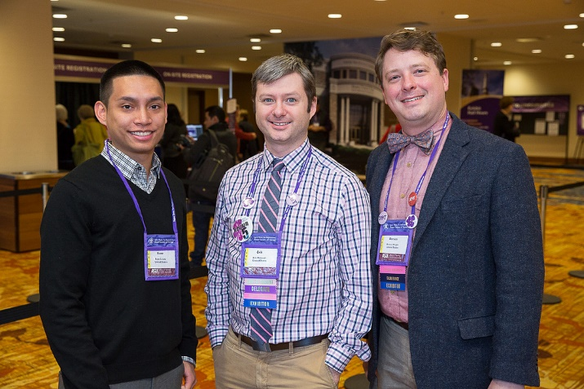

Slide 13

Greek Name Chapter

Slide 14
Accepting Membership
“I accept membership in
Sigma Theta Tau International,
and I pledge to fulfill its commitment
to nursing excellence, knowledge, service, and leadership
throughout my career.”

Slide 15
Inductees
List officer’s names
List officer’s names
List officer’s names
List officer’s names
List officer’s names
List officer’s names

Slide 16
Welcome
Inductees!

Slide 17
Inductees
Optional list names
Optional list names
Optional list names
Optional list names
Optional list names
Optional list names
Optional list names
Optional list names

Slide 18
In Absentia
Optional list names
Optional list names
Optional list names
Optional list names
Optional list names
Optional list names
Optional list names
Optional list names

Slide 19
Recognition of Transfer, Dual, and Multiple Members
Optional list names
Optional list names
Optional list names
Optional list names
Optional list names
Optional list names
Optional list names
Optional list names

Slide 20

Congratulations!

Slide 21
Installation of Officers
President, <<insert name>>
President-Elect, <<insert name or remove if n/a>>
Vice President, <<insert name>>
Secretary, <<insert name>>
Treasurer, <<insert name>>
Counselor, <<insert name>>

Slide 22
Installation of Officers
Director, <<insert name or remove if n/a>>
[OPTIONAL SLIDE]

Slide 23
Oath of Office
“I pledge to fulfill the duties of my position to the best of my ability and to work for the purposes of Sigma Theta Tau International.”

Slide 24


Slide 25


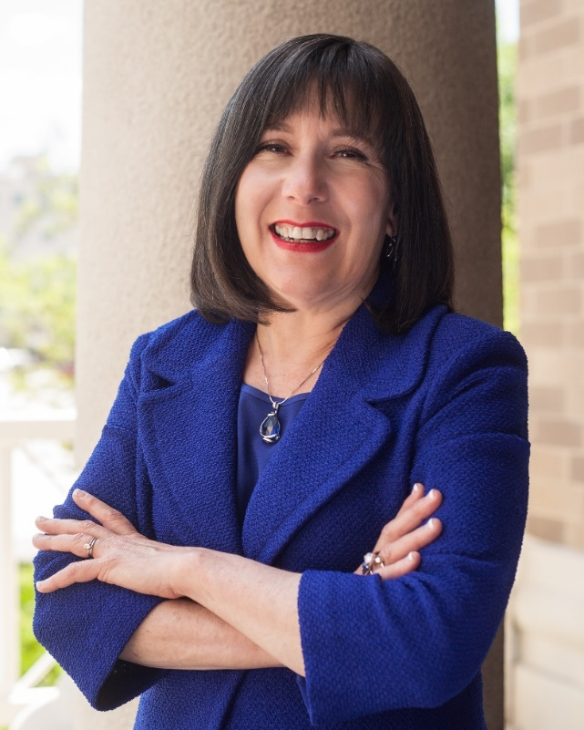
2017-2019
Presidential Call to Action
Beth Baldwin Tigges
PhD, RN, PNP, BC
2017-2019 Sigma President

Slide 26
CONNECT

Slide 27
COLLABORATE

Slide 28
CATALYZE

Slide 29

Thank you, colleagues, friends, and family.

Slide 30
Congratulations!

Slide 31
Please join us…

